Slide 1


Wumpus World
By Abdulrahman Zakrt

Slide 2
Outline
Introduction
Problem and Environment Definition (PEAS)
Solution
Basic Concept
Prolog
Tools Used
Basic Architecture
Class Diagram
Demonstration

Slide 3
Introduction

Slide 4
Wumpus World
A reasoning 2D game
Based on a knowledgebase agent

Slide 5
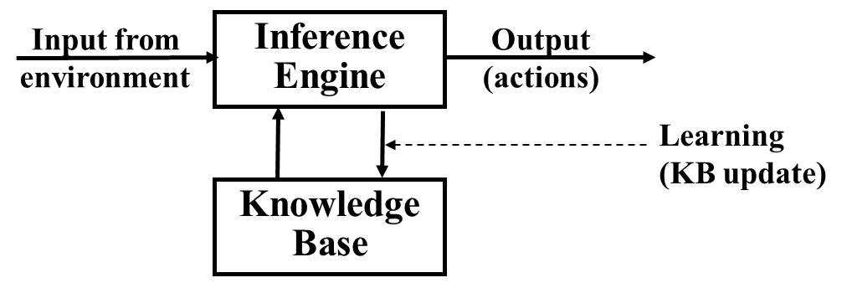
Knowledgebase Agents
The central component of a knowledge-based agent is its knowledge base
A knowledge base is a set of sentences/logical sentence
An inference engine is used to make inferences from the knowledge base
Tell(Fact) - It tells the knowledge base what it perceives.
Ask () It asks the knowledge base what action it should perform

Slide 6
Problem and Environment Definition(PEAS)

Slide 7
Problem
The agent explores a cave consisting of rooms connected to each other
In one of the rooms of the cave lies a Wumpus
Stench around wumpus
Some rooms contain bottomless pits
Breezes around pits
The agent can only move in a 1 step fashion either vertically or horizontally
The agent should find the gold in one of the rooms
The agent wins when he finds the gold and returns to the start

Slide 8
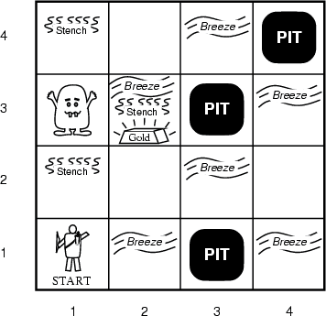
Environment
An n × n grid of rooms with the following:
The agent starting from square [1,1]
The gold is in one square
There are Wumpuses in one square, from which it never moves
Some pits in random squares
The starting square [1,1] has no Wumpus, no pit, and no gold

Slide 9
Actuators and Sensors
Actuators
Turn 90◦ left or right
Walk one square forward in the current direction
Grab an object in this square
Shoot the single arrow in the current direction, which flies in a straight line until it hits a wall or the Wumpus.
Sensors
stench when the Wumpus is in an adjacent square
breeze when an adjacent square has a pit
glitter when the agent perceives the glitter of the gold in the current square
bump when the agent walks into an enclosing wall
scream when the arrow hits the Wumpus, killing it.

Slide 10
Performance Measure
+1000 points for picking up the gold — this is the goal of the agent
−1000 points for dying = entering a square containing a pit or a live Wumpus monster
−1 point for each action taken, and
−10 points for using the arrow trying to kill the Wumpus

Slide 11
Solution

Slide 12
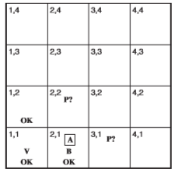
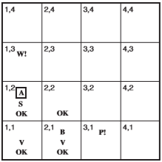
Basic Concept

Slide 13
Prolog
Tell() function is equivalent to sensebreeze
ask() function is equivalent to ispit
sensebreeze(aTrue,[X,Y]):-
A1 is X+1 , (nopit([A1,Y]);assert(ispit([A1,Y]))),
A2 is X-1 , (nopit([A2,Y]);assert(ispit([A2,Y]))),
A3 is Y-1 , (nopit([X,A3]);assert(ispit([X,A3]))),
A4 is Y+1 , (nopit([X,A4]);assert(ispit([X,A4]))).
sensebreeze(aFalse,[X,Y]):-
A1 is X+1 , retractall(ispit([A1,Y])), assert(nopit([A1,Y])),
A2 is X-1 , retractall(ispit([A2,Y])), assert(nopit([A2,Y])),
A3 is Y-1 , retractall(ispit([X,A3])), assert(nopit([X,A3])),
A4 is Y+1 , retractall(ispit([X,A4])), assert(nopit([X,A4])).

Slide 14
Tools Used
C# for main game and environment
Prolog as the knowledgebase and inference engine
PLEngine as the intermediary between C# and prolog
String[] param = { "-q", "-f", "Agentkb.pl" };
PlEngine.Initialize(param);
String line= "sensebreeze(a" + breeze + ",["+x+","+y+"])";
PlQuery.PlCall(line);

Slide 15
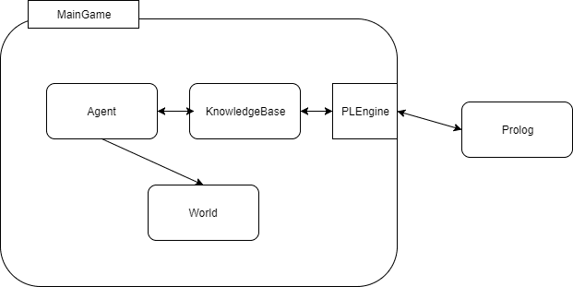
Architecture

Slide 16
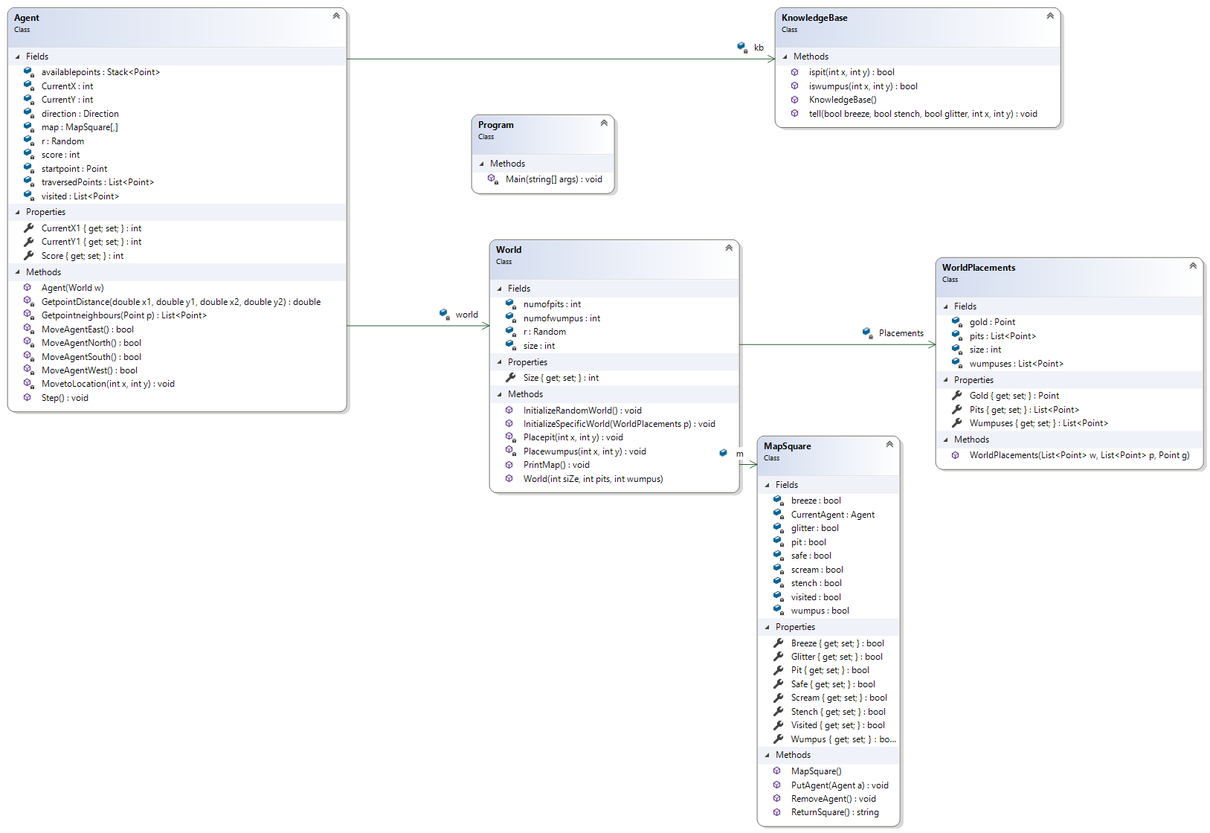
Class Diagram

Slide 17
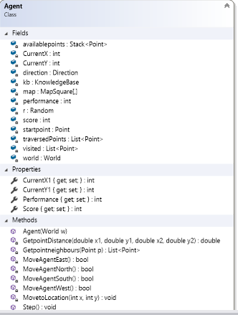
Agent Class

Slide 18
The Step Function
Tell the knowledgebase the senses [stench,breeze,glitter,scream]
Check if there is gold in the current node if yes take the gold and return to 1,1 other wise continue
For each non-visited neighbor of the visited nodes ask the knowledgebase if there is a Wumpus or a pit
If a safe node is found move to that node otherwise pick a random node to move to

Slide 19
Move to location (X,Y)
A recursive function that makes the agent move east, north, south and west to find a route through the visited nodes to go to location (x,y)
Uses greedy best first search
Heuristic is the distance between two points
Backtrack in case of failure

Slide 20
Demonstration

Slide 21
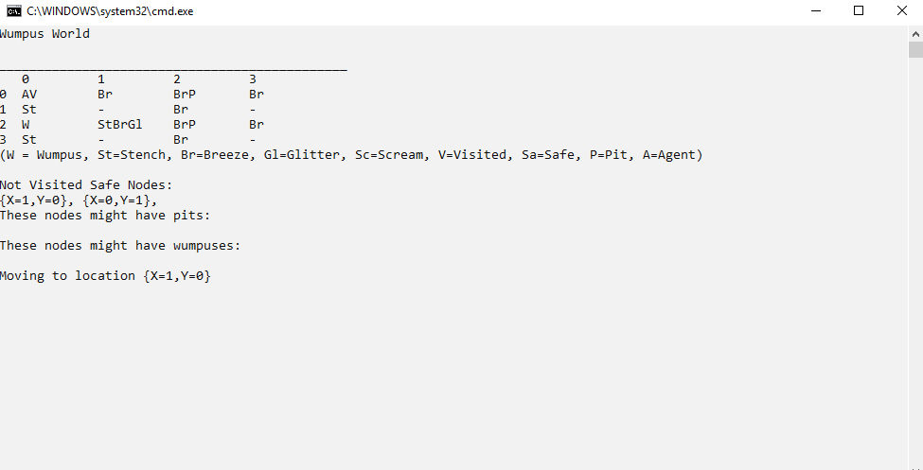

Slide 22
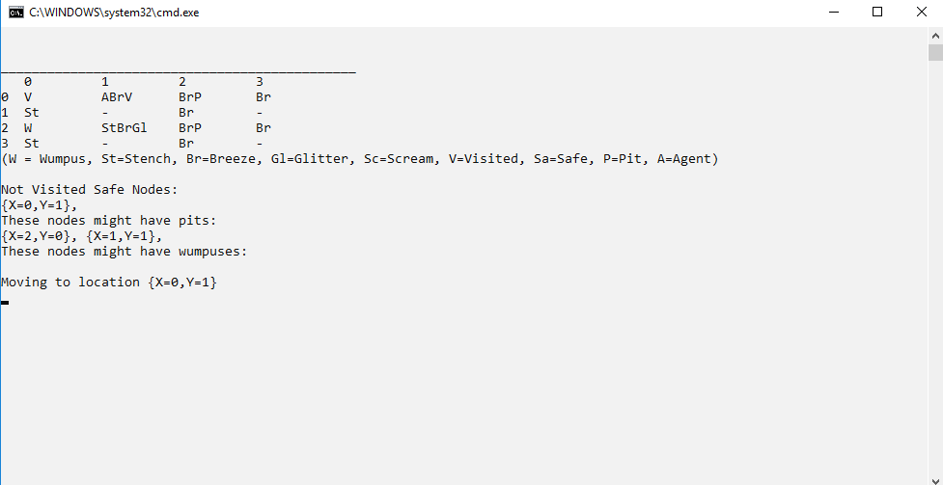

Slide 23
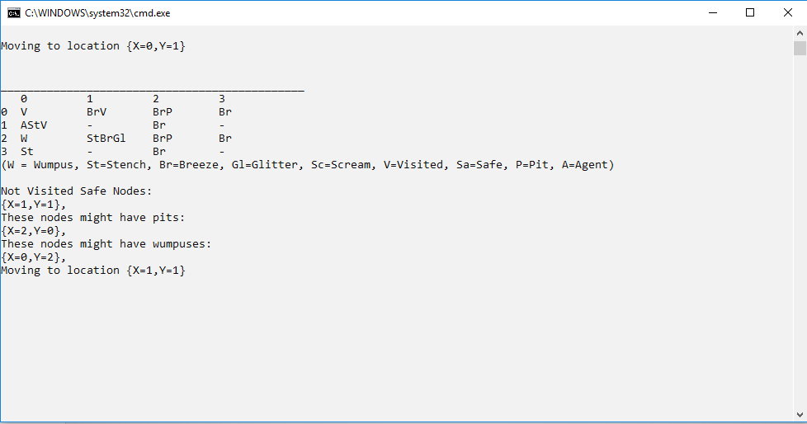

Slide 24
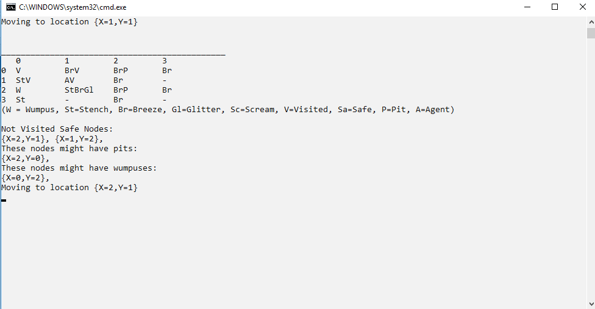

Slide 25
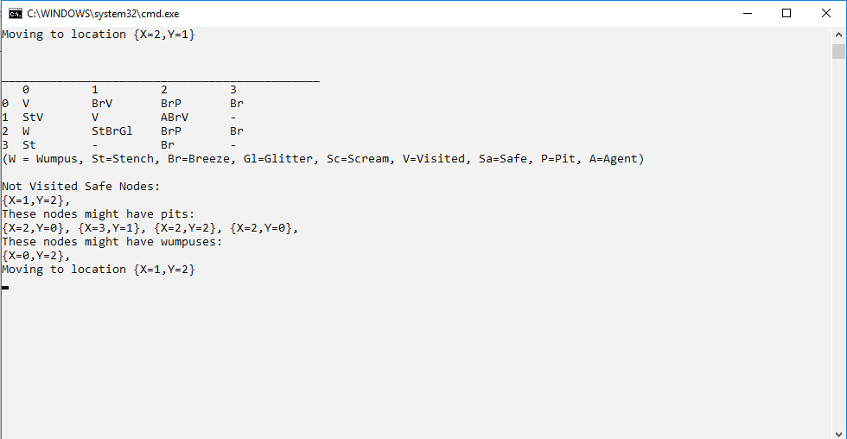

Slide 26
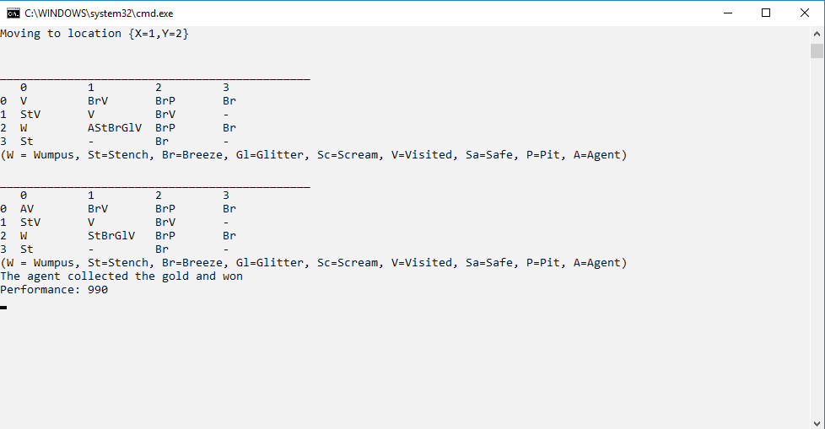

Slide 27
Test results
Parameters | Results for 500 times
size = :4 pits = 2 wumpuses = 1 | Died: 254 Lived: 246
size = :10 pits = 5 wumpuses = 1 | Died: 69 Lived: 431
size = :10 pits = 5 wumpuses = 5 | Died: 169 Lived: 331
size = :15 pits = 10 wumpuses = 5 | For 100 times: Died: 21 Lived: 79
size = :15 pits = 15 wumpuses = 15 | For 100 times: Died: 65 Lived: 35

Slide 28
Conclusion

Slide 29
Thank You
Have a nice day

